Slide 1
Machine Learning
Lecture Notes

Slide 2
Predicting with Trees
The basic idea is that if you have a bunch of variables that you want to use to predict an outcome
You can take each of those variables, and iteratively split the outcome into different groups.
Then you can evaluate the homogeneity of the outcome within each group.
… And continue to split again if necessary,
Until you get outcomes that are separated into groups that are
Homogeneous enough, - or - they are small enough that you need to stop.
The pros of this approach are
It’s easy to interpret right,
And you tend to get better performance in non-linear settings than you do with the linear regression models we talked about in the previous lectures.
The cons are that without precluding or some kind of cross-validation,
This can lead to overfitting.
And they can be harder to estimate uncertainty than it can be for the linear regression model setting.
In general the results may be variable depending on exact values of the parameters, or the variables that you collected.

Slide 3
Example Obama-Clinton Divide
http://graphics8.nytimes.com/iomages/2008/04/16/us/0416-nat-subOBAMA.jpg
Outcome is homogeneous for each leaf
Is a county more than 20% black?
Yes – Obama wins these 383-70
No – And is the high school graduation rate higher that 78%?
No – Clinton wins these 704 to 89
Yes – And is the high school graduation rate higher than 87%?
Yes – Obama wins these 185 to 36
No –
North or South – Clinton wins these counties 182 to 79
West or Midwest
In 2000 were many households poor?

Slide 4
Basic Algorithm
Start with all variables in one group
Find the variable/split that best separates the outcomes
Divide the data in to 2 groups (“leaves”) on that split (“node)
Within each split, find the best variable/split that separates the outcomes
Continue until the groups are too small or sufficiently “pure”
Start with all the variables of one big group. And then, you find the first variable that best splits the outcomes into two different homogenous groups.
You then divided the data into two groups which we call leaves, and on, and the split that you just performed is called a node.
Within each split, we then search through all the variables, again including the variable we just split on and try to find within that group if there's another variable or split that separates the outcome, into even more homogeneous groups.
You continue until the groups are too small, or they're sufficiently pure.
In other words, sufficiently homogeneous to, stop the algorithm.

Slide 5
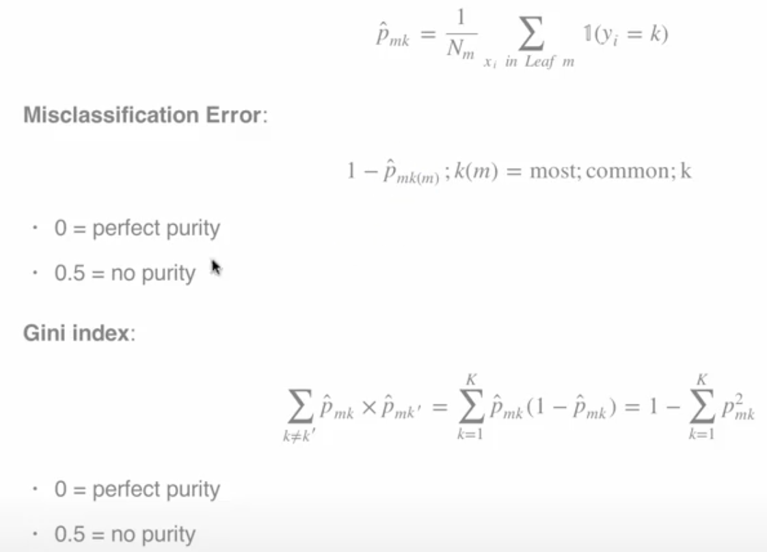
Measures of Impurity
So there are different measures of impurity. And they're all based on basically this probability that you can estimate. So, within a particular group. So, in the le, m, m leaf then you have n total objects that you might consider, and you can count the number of times that a particular class appears in that leaf. So this is the number of times that class k appears in leaf m. So that's this probability. So it's p hat for the mth leaf and the kth class. The misclassification error is 1 minus the probability that you're equal to the most common class in that particular leaf. So for example, if you're if it's a leaf where. Almost all of the counties would vote for Barack Obama, then 1 minus the misclassification error is 1 minus the er the misclassification error is 1 minus the probability that you'd vote for Barack Obama.
So zero means perfect purity. In other words, there's no misclassification error and all of the counties would go for Barack Obama. 0.5 means no purity because, it, it's not one, because in any particular leaf if the, counties was overwhelming, the counties where overwhelming likely to vote for Hilary Clinton then you would get perfect purity in the other direction. So it's actually when the leaf is perfectly balanced between the two different outcomes, that's when you don't have homogeneity within that particular leaf.
Similarly there's something called the Gini index which is not to be confused with the Gini coefficient in economics,. And it's basically 1 minus the sum of the squared probabilities that you belong to any of the different classes. So again zero means perfect purity. In other words the class has one particular class has probability equal to 1 and all the other classes have probability equal to 0. 0.5 means no purity. In other words, all of the classes are perfectly balanced within each leaf.

Slide 6
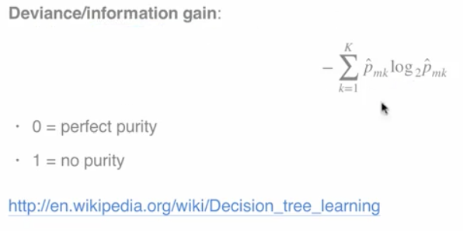
Deviance & Information Gain
Deviance and information gain is another measure that can be used, and so, it's called deviance if you use log with base e here, and log base 2 is information gain. And it's basically minus the sum of the probability. Of being assigned to class k and leaf m times the log base 2 or base e, of that same probability.
Value of zero means there is perfect purity within the leaf, and value of one means there's no purity. If you go to this link from Wikipedia, you'll have a lot more information about how these measures of impurity are used to separate the, the values within each leaf.

Slide 7
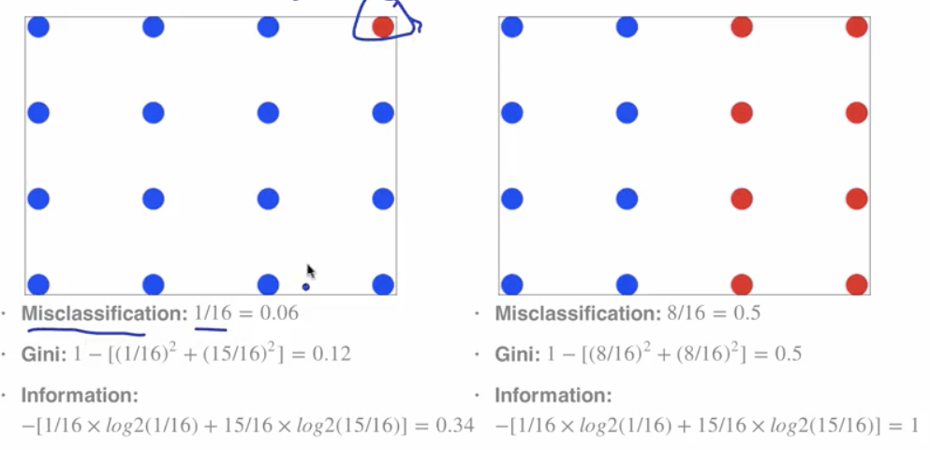
Examples

Slide 8
Example: Iris Data
Data(iris); library(ggplot2)
Names(iris) (variabes we’re trying to predict)
[1] “Sepal.Length” “Sepal.Width” “Petal.Length” “Petal.Width” “Species” ##We’re trying to predict the species
Table(iris$Species)
Setosa versicolor virginica
50 50 50
inTrain <- createDataPartition(y=iris$Species, p=0.7, list = FALSE) ## always separate the data into the training and test sets
Training<-iris[inTrain,]
Testing<-iris[-inTrain,]
Dim(training); dim(testing)
[1] 45 5
plot Iris petal widths/sepal width
qplot(Petal.Width,Sepal.Width,colour=Species,data=training)

Slide 9
Fit the model with train()
Library(caret)
modFit<-train(Species~.,method="rpart",data=training)
print(modFit$finalModel)
OUTPUT
What all the nodes are
How they’re split
Probability of being in each class for each split
n= 105
node), split, n, loss, yval, (yprob)
* denotes terminal node
1) root 105 70 setosa (0.33333333 0.33333333 0.33333333)
2) Petal.Length< 2.45 35 0 setosa (1.00000000 0.00000000 0.00000000) *
3) Petal.Length>=2.45 70 35 versicolor (0.00000000 0.50000000 0.50000000)
6) Petal.Width< 1.75 39 5 versicolor (0.00000000 0.87179487 0.12820513) *
7) Petal.Width>=1.75 31 1 virginica (0.00000000 0.03225806 0.96774194) *
outcome
R’s method for regression and classification trees
Use all remaining vars

Slide 10
Plot classification tree
## plot the classification tree
plot(modFit$finalModel, uiform=TRUE,main="Classification Tree")
text(modFit$finalModel, use.n=TRUE, all=TRUE, cex=.8)
Petal Length <2,.45 you are assigned to setosa
Petal Length not<2,.45 you are assigned to setosa

Slide 11
Prettier plots
## prettier plots with the rattle package
library(rattle) ## Rattle not working
fancyRpartPlot(modFit$finalModel)
## using rattle alternative rpart.plot() rpart.plot()install.packages("rpart.plot")
library(rpart.plot)
rpart.plot(modFit$finalModel)
Petal Length not<2,.45 you are assigned to setosa
Petal Length <2,.45 you are assigned to setosa

Slide 12
Predicting new values
Predict(modFit,newdata=testing)
[1] setosa setosa setosa setosa setosa setosa setosa setosa setosa setosa setosa
[12] setosa setosa setosa setosa setosa setosa setosa setosa setosa setosa setosa
[23] setosa setosa setosa setosa setosa setosa setosa setosa setosa setosa setosa
[34] setosa setosa versicolor versicolor versicolor versicolor versicolor versicolor versicolor versicolor versicolor
[45] versicolor versicolor versicolor versicolor versicolor virginica versicolor versicolor versicolor versicolor versicolor
[56] versicolor versicolor versicolor versicolor versicolor versicolor versicolor versicolor versicolor versicolor versicolor
[67] versicolor versicolor versicolor versicolor virginica virginica versicolor virginica virginica virginica virginica
[78] virginica virginica virginica virginica virginica virginica versicolor virginica virginica virginica virginica
[89] virginica versicolor virginica virginica versicolor versicolor virginica virginica virginica virginica virginica
[100] virginica virginica virginica virginica virginica virginica
Levels: setosa versicolor virginica
This writes out each species because it’s actually predicting a class for each variable

Slide 13
Notes and further resources
Classification trees are non-linear models
They use interactions between variables
Data transformations may be less important (monotone transformations)
Trees can also be used for regression problems (continuous outcome)
Note that there are multiple tree building options in R both in the caret package – party, rpart and out of the caret package - tree
Classification trees are non-linear models, so they immediately use interactions between variables,
this is important to keep in mind, because it's always a model that's built on the relationship between multiple variables and if you have a large number of classes for a particular variable for example that you're predicting with. The models can over-fit a little bit.
The data transformations may be a little bit less important. If you do any monotone transformation of a continuous variable,
in other words, any transformation that doesn't change the order of the values, but maybe makes them bigger or smaller. Then you will get the same data splits, with the classification or regression trees. This can make the transformations a little bit less important. They can also be used for regression problems.
So, I showed measures of misclassifcation impurity, you can also use root mean squared error as a measure of impurity.
And do a similar classification tree building procedure for building models for regression as well.

Slide 14
Bagging
Bootstrap Aggregating

Slide 15
Basic Idea
Resample cases and recalculate predictions
Average or majority vote
Notes
Similar bias
Reduced variance
More useful for non-linear functions
The basic idea is take your data and take resamples of the data set.
So, this is the similar to the idea of bootstrapping, which you would have learned about in the inference class that is part of the data science specialization.
After you resample the cases with replacement, then you recalculate your prediction function on that resampled data.
And then you either average the predictions from all these repeated predictors that you built or you majority vote or something like that when you're doing classification.
The thing is that you get a similar bias that you would get from fitting any one of those models individually,
but a reduced variability because you've averaged a bunch of different predictors together.
This is most useful for non-linear functions.
So, we'll show an example with smoothing, but it's also very useful for things like predicting with trees.

Slide 16
Ozone data bagging example
Ref http://en.Wikipedia.org/wiki/Bootstrap_aggregating
install.packages("ElemStatLearn")library(ElemStatLearn)
data(ozone,package="ElemStatLearn")
ozone<-ozone[order(ozone$ozone),]
I’m going to try to predict temperature as a function of ozone with Bagged loess
Head(ozone)
head(ozone)
ozone radiation temperature wind
1 8 59 9.7
4 25 61 9.7
6 78 57 18.4
7 48 80 14.3
7 49 69 10.3
7 8 19 61 20.1

Slide 17
Ozone example Bagged loess
ll <- matrix(NA,nrow=10,ncol=155)
for(i in 1:10){
ss<-sample(1:dim(ozone)[1],replace=T)
ozone0 <- ozone[ss,]
ozone0 <-ozone0[order(ozone0$ozone),]
loess0<-loess(temperature~ozone,data=ozone0,span=0.2)
ll[i,] <- predict(loess0,newdata=data.frame(ozone=1:155))
}
So what I've done here?
I've resampled my data set ten different times,
fit a smooth curve through it those ten different times,
and then I'm going to average those values.
Resample the data set 10 different times
Each time with replacement with the entire dataset
Subset according to our random sample ss
Then re-order the data every time by the ozone variable
Then fit a loess (smooth) curve each time relating temperature to the ozone variable – very similar to the spline model fit in a previous example
-each time using the sample dataset as the dataset I’m building the predictor on with a common span for each time (0.2)
Then predict for every loess curve the outcome for a new dataset using the exact same values (ozone values 1:155)

Slide 18
Ozone example bagged loess - continued
Plotting the results
plot(ozone$ozone,ozone$temperature,pch=19,cex=0.5)
For( in 1:10){
lines(1:155,ll[I,],col="grey",lwd=2)
lines(1:155,apply(ll,2,mean),col="red",lwd=2)
}
## the grey lines are the loess averages for each of the samples
## the red line is the bagged loess curve average of the grey lines
Some models perform bagging for you, in train function consider the method options- bagEarth- treebag- bagFDA
Alternatively you can bag any model you choose using the bag function
So if you're using the train function you could set method to be bagEarth, treebag, or bagFDA. And those are specific bagged models that the the model that the caret package will fit for you.

Slide 19
Custom Bagging
Alternatively, you can build your own bagging function in caret. This is an advanced use and so I recommend that you read the documentation carefully if you're going to be trying to do that yourself.
The idea here is you take your predictor variable and put it into one data frame. So I'm going to make the predictors be a data frame that contains the ozone data.
Then you have your outcome variable. Here's it's going to be just a temperature variable from the data set.
And I pass this to the bag function in caret package. <<see code on next page>>
So I tell it I want to use the predictors from that data frame, this is my outcome, this is the number of replications with the number of sub samples I'd like to take from the data set. And then bagControl tells me about how I'm going to fit the model.
Fit is the function that's going to be applied to fit the model every time. This could be a call to the train function in the caret package.
Predict is a the way that given a particular model fit, that we'll be able to predict new values. This could be, for example, a call to the predict function from a trained model.
And then aggregate is the way that we'll put the var, the predictions together. For example it could average the predictions across all the different replicated samples.
You look at this custom bag version of the conditional regression trees, you can see that it gets some of the benefit that I was showing you in the previous slide with bag loess.

Slide 20
Custom Bagging
Here I'm plotting ozone again on the x-axis versus temperature on the y-axis. The little grey dots represent actual observed values.
The red dots represent the fit from a single conditional regression tree.
You can see that for example, it doesn't capture the trend that's going on down here very well, the red line is just flat. Even though there appears to be a trend upward in the data points here.
But when I average over ten different bagged model model fits with these conditional regression trees I see that there's an increase here in the values in the blue fit, which is the fit from the bagged regression.
Note this code did not work but is in the Week3-Lectured in the R project
predictors = data.frame(ozone=ozone$ozone)temperature = ozone$temperature ## this will be the outcome variable
treebag <- bag(predictors, B = 10, bagControl = bagControl(fit = ctreeBag$fit, ## this is the function call to be applied
predict = ctreeBag$pred, ## call to prediction from a trained model
aggregate = ctreeBag$aggregate)) ## how to put the predictions together (could be average for instance)
http://www.inside-r.org/packages/cran/caret/docs/nbBag
## plot
plot(ozone$ozone,temperature,col='lightgrey',pch=19)
points(ozone$ozone,predict(treebag$fits[[1]]$fit,predictors),pch=19,col="red")
points(ozone$ozone,predict(treebag,predictors),pch=19,col="blue")

Slide 21
Bagging Notes
Notes
Bagging is most useful for nonlinear models
Often used with trees - an extension is random forests
Several models use bagging in caret's train function

Slide 22
Random Forests

Slide 23
Random Forests
Bootstrap samples
At each split, bootstrap variables
Grow multiple trees and vote
Pros:
Accuracy
Cons
Speed
Interpretability
Overfitting
It’s very important to use cross-validation when building random forests
The basic idea is very similar to bagging in the sense that we bootstrap samples
We take a resample of our observed data, and our training data set.
Then we rebuild classification or regression trees on each of those bootstrap samples.
The one difference is that at each split, when we split the data each time in a classification tree, we also bootstrap the variables.
In other words, only a subset of the variables is considered at each potential split.
This makes for a diverse set of potential trees that can be built.
So the idea is we grow a large number of trees. Then we either vote or average those trees in order to get the prediction for a new outcome.
The pros for this approach are that it's quite accurate.
The cons are that it's, it can be quite slow. It has to build a large number of trees. And it can be hard to interpret, in the sense that you might have a large number of trees that are averaged together. And those trees represent bootstrap samples with bootstrap nodes that can be a little bit complicated to understand.

Slide 24
Example Random Forest
So the idea is that you build a large number of trees where each tree is based on a bootstrap sample.
So, for example, this tree (t1) is built on a random subsample of your data and this (t2) is a separate random subsample of the data and this (t3) is a separate random subsample of the data.
And then at each node we allow a different subset of the variables to potentially contribute to the splits.
Then if we get a new observation, say this V observation here, we run that observation through tree one, and it ends up at this leaf down here at the bottom of that tree. And so it gets a particular prediction here.
Then the next, we take that same observation, we run it through the next tree, and it goes down a slightly different leaf, and it gets a slightly different set of predictions here. And finally we go down the third tree, and we get an even different set of predictions.
Then we average those predictions together in order to get the predictive probabilities of each class across all the different trees.
http://www.robots.ox.ac.uk/~az/lectures/ml/lect5.pdf

Slide 25
Code Example random forest using iris
data(iris); library(ggplot2)
## build training and test data sets
inTrain <- createDataPartition(y=iris$Species, p=0.7, list=FALSE)
training<-iris[inTrain,]; testing<-iris(-inTrain,]
library(caret); library(randomForest)
modFit<-train(Species~.,data=training,method="rf",prox=TRUE)
## use Species for the outcome and all other vars as predictors
## rf refers to random forest
## prox=TRUE provides a little more information when building these
modelsmodFit
##---results –
Random Forest 105 samples
4 predictor
3 classes: 'setosa', 'versicolor', 'virginica’
* This code is in the Weelk3-Lectures R note
--results (continued)
## mtry = the number of repeated trees it's going to build
mtry Accuracy Kappa
2 0.9511811 0.9252580
3 0.9501302 0.9234816
4 0.9514098 0.9254189
Accuracy was used to select the optimal model using the largest value.
The final value used for e model was mtry = 4.
I can look at the output of a specific tree thusly:
getTree(modFit$finalModel,k=2)
## here I'm calling for the 2nd tree out (k=2)
In the output each of the rows refers to a particular split

Slide 26
Random Forest Class “Centers”
centers for the predicted values.
You can use centers information to see what the predictions would be for the center of the class predictions.
So I'm looking at two particular variables. The petal length and the petal width.
So I plotted petal width on the X axis and petal length on the Y axis.
I then get the class centers.
So these are going to be the centers for the predicted values.
So I'm going to send in the model fit, and I'm going to give it this prox variable which we asked for in the previous fitting. And when I'm going to tell it we're looking at the training data set. And so that gives us the class centers.
We can then plot those class centers to see where they fall in the data. So now, I've created the centers data set, as well as the species data set.
irisP <- classCenter(training[,c(3,4)], training$Species, modFit$finalModel$prox)
irisP <- as.data.frame(irisP) ## the centers dataset
irisP$Species <- rownames(irisP) ## the Species dataset

Slide 27
Plotting random forest centers
And what I'm going to do is plot petal width versus petal length.
And I'm going to color it by species in the training data. That's what I did with this qplot command.
Then I'm going to add points on top of that. That are the petal width and petal length, corresponding to the color being the species, and now I am using it from the irsP which is the centers of the data set.
So what you can see is each dot here represents an observation.
And the x's show the color center, or the observation centers for each of the different predictions.
So you can see that we predict the, each species has a prediction for these two variables that's right in the center of the cloud of points corresponding to that particular species.
p <- qplot(Petal.Width, Petal.Length, col=Species,data=training)
p + geom_point(aes(x=Petal.Width,y=Petal.Length,col=Species),size=5,shape=4,data=irisP)

Slide 28
Predict Random Forest
Predict new values using the predict function
pred <- predict(modFit,testing)
testing$predRight <- pred==testing$Species
table(pred,testing$Species)
I can then check to see what I missed…
qplot(Petal.Width,Petal.Length,colour=predRight,data=testing,main="new data Predictions")
--- Results ---
pred setosa versicolor virginica
setosa 15 0 0
versicolor 0 15 0
virginica 0 0 15

Slide 29
Notes and further resources
Random forests are usually one of the two top performing algorithms along with boosing in prediction contests.
Random forests are difficult to interpret but often very accurate
Care should be taken to avoid overfitting (see rfcv function) the cross validation function
Further resources
Random forests
Random forest Wikipedia
Elements of Statistical Learning

Slide 30
Boosting
Another classifier besides random forests

Slide 31
Basic idea
Take lots of (possibly) weak predictors
Weight them and add them up
By averaging them together we get a stronger predictor
Start with a set of classifiers h1…..,hk
Examples: all possible trees, all possible regression models, all possible cutoffs.
Create a classifier that combines classification functions: f(x)=sgn(Sigma(T..t=1)alpha-t h-t (x))
Goal is to minimize error (on training set)
Iterative, select one h at each step
Calculate weighjts based on errors that we get from that original h
Upweight missing classifications and select next h
Adaboost on Wikipedia – the most famous boosting algorithm
http://webee.technion.ac.il/people/rmeir/BoostingTutorial.pdf (contains material for this lecture)
Alpha-t is the weight
F(x) is prediction for the new point
H-t (x) is a classifier instance

Slide 32
Simple boosting example
Suppose we're trying to separate the blue plus signs, from the red minus signs, and we have two variables to predict with.
So here I plotted variable one on the x-axis, and variable two on the y-axis.
We haven't named them because this is just a very simple example. And so the idea is, can we build a classifier that separates these variables from each other?
We could start off with a really simple classifier.
We could say just draw a line a vertical line, and say, which vertical line separates these points well?
Here's a classifier that says anything to the left of this vertical line is a blue plus, and anything to the right is a red minus, and so you can see we've misclassified these three points up here in the top right.

Slide 33
Simple boosting example (round 1)
So the thing that we would do is build that classifier, calculate the error rate, in this case we're missing about 30% of the points. And then we would upweight those points that we missed.
Here I've shown that upweighting, by drawing them in a larger scale. So those pluses are now upweighted, for building the next classifier.

Slide 34
Simple boosting example (round 2 & 3)
We would then build the next classifier. And in this case, our second classifier would be, one that drew a vertical line right over here.
And so, that vertical line would classify everything to the right of that line as a red minus. And everything to the left, as a blue plus.
And so here we again, misclassified three points, these three right here. And so, those three points are now upweighted, and they are also drawn larger for the next iteration.
So we can again calculate the error rate, and use that to calculate the weights for the next step.
Then the third classifier, will intentionally try to classify those points that we misclassified in the last couple of rounds. So, for example, these pluses, and these minuses need to be correctly classified.
To do that we now draw a horizontal line, and we say anything below that horizontal line is a red minus, anything above is a blue plus, and now we misclassify this point, and these two points over here.

Slide 35
Simple boosting example (Completed classifier)
So then we can take those classifiers, and we can weight them, and add them up,
So we classify a weighted combination of 0.42 times the first vertical line. Plus 0.65 times the second vertical line, plus 0.92 times the classification given by this horizontal line.
Once you add these classification rules up together, you can see that our classifier works much better now.
We get, to a much better classification when adding them up, that gets all of the blue pluses, and all of the red minuses together.
So in each case, each of our classifiers was quite simple, was just a line across the plane, and so, it's actually quite a naive classifier.
But when you weight them and add them up, you can get quite a strong classifier at the end of the day.

Slide 36
Boosting in R
Boosting can be used with any subgset of classifiers
One large subclass is gradient boosting
R has multiple boosting libraries. Differences include the choice of basic classification functions and combination rules.
gbm – boosting with trees
mboost – model based boosting
ada – statistical boosting based on additive logistic regression
gamBoost for boosting generalized additive models
Most of these are available in the caret package

Slide 37
Boosting – Wage example
--code— see code in Week3-Lectures R notes
install.packages("ISLR"); library(ISLR); data(Wage); library(ggplot2); library(caret);
Wage <- subset(Wage,select=-c(logwage))
inTrain <- createDataPartition(y=Wage$wage, p=0.7, list=FALSE)
training <- Wage[inTrain,]; testing <- Wage[-inTrain,]
We can then fit the model using wage as the outcome and all other vars as predictors
--code—
install.packages("gbm"); library(gbm)
modFit <- train(wage~.,method="gbm",data=training,verbose=FALSE)
## gbm method does boosting with trees
## produces a lot of output if you don't use verbose=FALSE
print(modFit)
## look at the model against the testing dataset and plot
qplot(predict(modFit,testing),wage,data=testing)

Slide 38
Notes and Further Reading
Tutorials for boosting
Freund and Shapire – http://www.cc.gatech.edu/~thad/6601-gradAI-fall2013/boosting.pdf
Ron Meir – http://webee.technion.ac.il/people/rmeir/BoostingTutorial.pdf
Boosting, random forests, and model ensembling are the most common tools that win Kaggle and other prediction contests.
http://www.netflixprize.com/assets/GrandPrize2009_BPC_BigChaos.pdf
http://kaggle2.blob.core.windows.net/wiki-files/327/09ccf652-8c1c-4a3d-b979-ce2369c985e4/Willem%20Mestrom%20-%20Milestone%201%20Description%20V2%202.pdf

Slide 39
Model Based Prediction

Slide 40
Basic Idea
Assume the data follow a probabilistic model
Use Bayes' theorem to identify optimal classifiers
Pros:
Can take advantage of structure of the data
May be computationally convenient
Are reasonably accurate on real problems
Cons:
Make additional assumptions about the data
When the model is incorrect you may get reduced accuracy

Slide 41
Model based approach

Slide 42
Classifying using the model
A range of models use this approach
Linear discriminant analysis assumes fk(x) is multivariate Gaussian with different covariances
Quadratic discrimant analysis assumes fk(x) is multivariate Gaussian with different covariances
Model based prediction assumes more complicated versions for the covariance matrix
Naïve Bayes assumes independence between features for model building
http://statweb.Stanford.edu/~tibs/ElemStatLearn/
In each of the classes

Slide 43
Why linear discriminant analysis?
In each of the classes
http://statweb.Stanford.edu/~tibs/ElemStatLearn/

Slide 44
Decision Boundries
Fitting one Gaussian distribution to each class (green, yellow, blue)
In each of the classes using 2 variables (x and y axis)
Draw lines where the probability switches from this class to that class

Slide 45
Discriminant function

Slide 46
Naive Bayes
Assuming all the features are independent – this is the naïve part

Slide 47
Model based prediction Example: Iris Data
--code
data(iris); library(ggplot)
names(iris)
table(iris$Species)
setosa versicolor virginica
50 50 50
## create training and test data sets
library(caret)
inTrain<-createDataPartition(y=iris$Species,p=0.7,list=FALSE)
training<-iris[inTrain,]; testing<-iris[-inTrain,]
## Build predictions
(LDA = Model linear discriminate analysis)
modlda = train(Species~.,data=training,method="lda") ## lda model
modnb = train(Species~.,data=training,method="nb") ## naive bayes
plda = predict(modlda,testing)pnb = predict(modnb,testing)
table(plda,pnb) ## make a table of the predictions
## -- results
pnb
plda setosa versicolor virginica
setosa 15 0 0
versicolor 0 16 0
virginica 0 1 13
# -- we can see the predictions agree except on one value
I want to be able to predict Species

Slide 48
Comparison of results
## -- comparison of results
equalPredictions = (plda==pnb)
## create plot
qplot(Petal.Width,Sepal.Width,color=equalPredictions,data=testing)
## we see one value not classified in the same way as all the others (see chart)

